Slide 1
Income Inequality in US
Data Visualization

Slide 2
Table of Contents
Background
Claim 1
Claim 2
Claim 3
Conclusion
Action items
Future Research

Slide 3
Background
What is income inequality?
Income: Revenue streams from wages, salaries, interest on savings account, dividends from shares of stock, rent, and profits from selling something for more than you paid for it.
Income inequality: Extent to which income is distributed in an uneven manner in a population.
What is GINI index?
A single statistic, which summarizes the dispersion of income across the entire income distribution.
0- perfect equality (everyone receives an equal share)
1- perfect inequality (one person or group receives all the income)

Slide 4
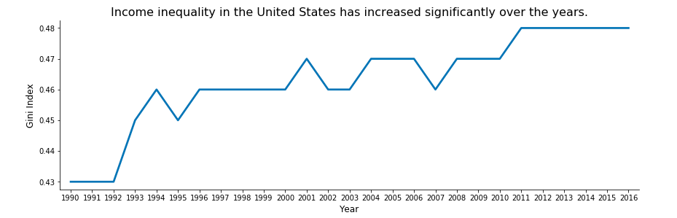
Income inequality in the United States has increased significantly over the years (1990-2016)
Source: Statista

Slide 5
Factors Explored:
Income Shares within the population
Unemployment Rate
Gender Disparity
Racial Disparity

Slide 6
Income Shares

Slide 7
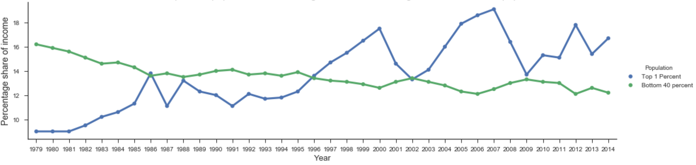
Claim 1 - Income Shares for the top 1 % Increasing and for the bottom 40% decreasing
Source: Congressional Budget Office

Slide 8
Unemployment Rate

Slide 9
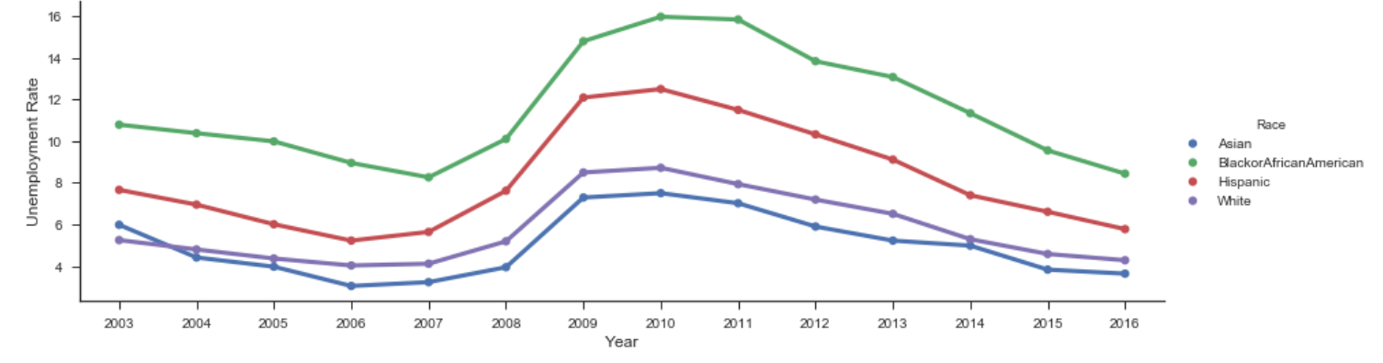
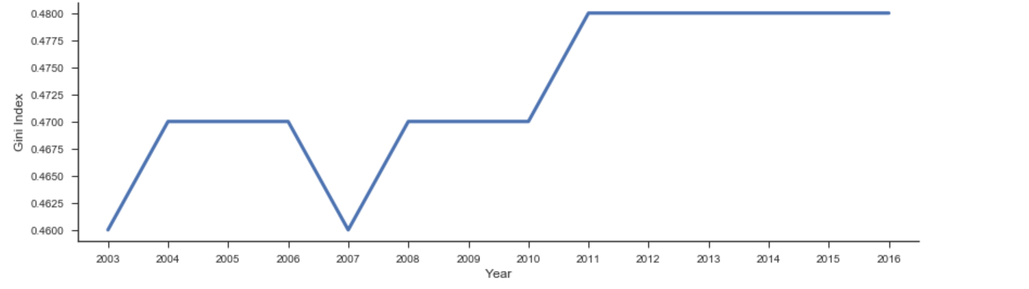
Unemployment rate doesn’t affect Gini Index Directly
Source: BLS.Gov
Source: Statista

Slide 10
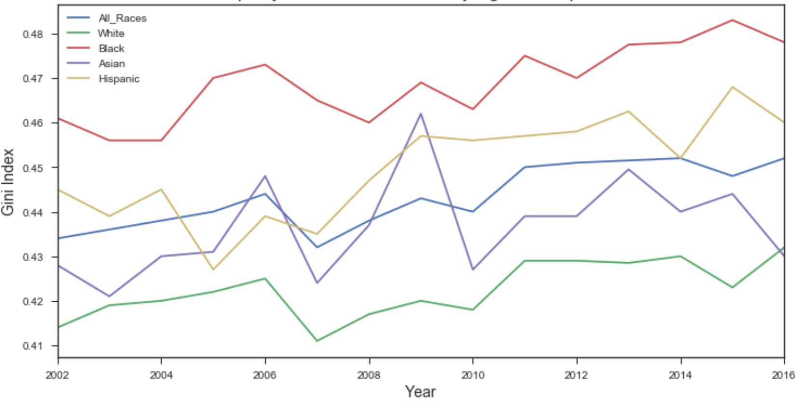
Income disparity between Black Race is very high as compared to others
Source: BLS.Gov

Slide 11
Gender Income Disparity

Slide 12
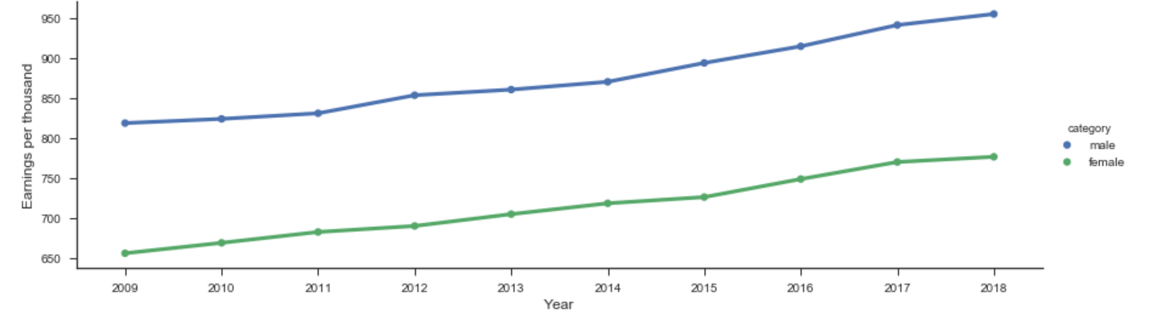
Claim2: Gap between Men & Women’s median salary has not decreased over the years
Resource: BLS.Gov

Slide 13
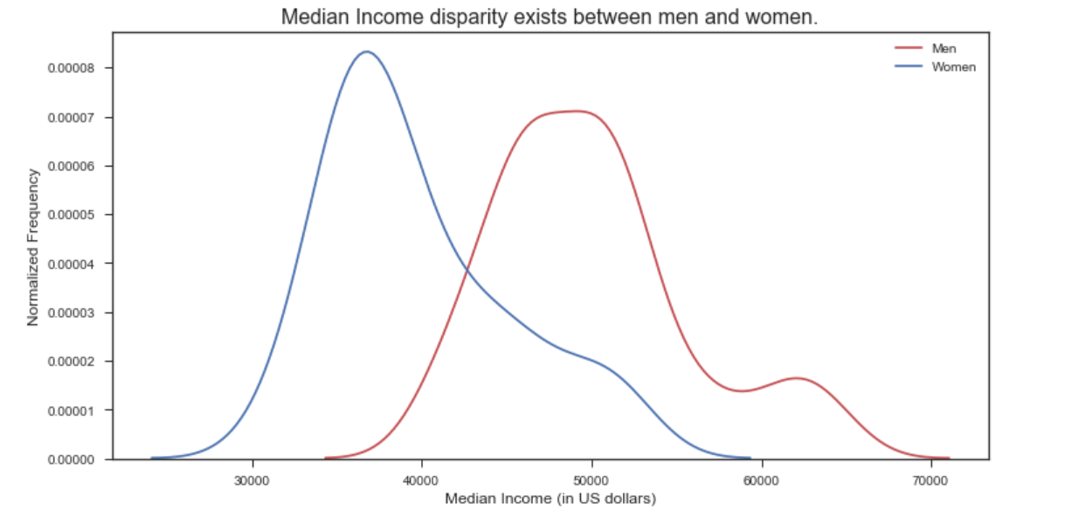
Claim: Median Income for women is way below than men
Notes:
Women have lesser standard deviation and higher peak here because most of the women tend to have a lower income around $35000 whereas the distribution is spread more for men. This could be because women are not given equal positions in organizations and earn equal wages and women tend to choose lower paying jobs because of other priorities.
According to some research(refer jupyter file) around 96% of works, males have higher wages than females in the same position - Source, Data USA

Slide 14
Racial Disparity

Slide 15
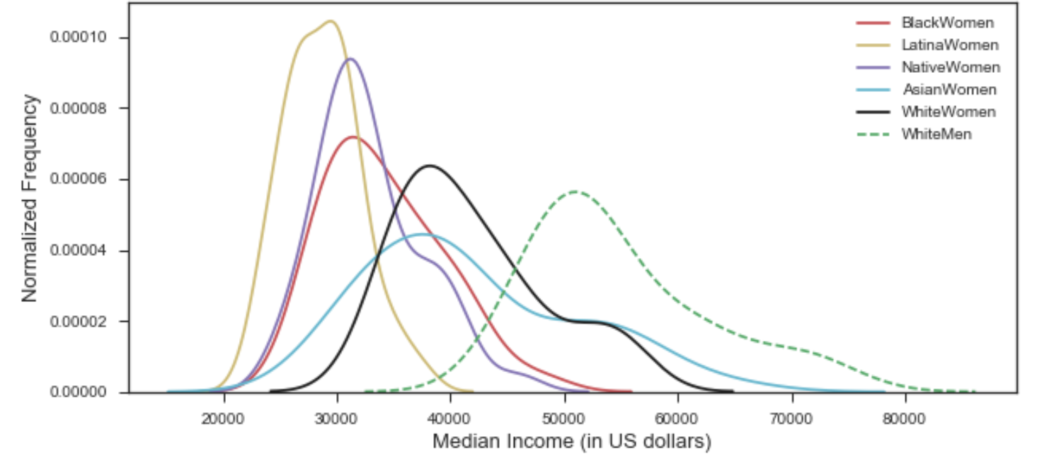
Claim 4: Racial Income disparity gaps persist in US
Notes:
Latina women, native women and black women have relatively lesser median income as compared to asian and white women.
They also have smaller standard deviation which means that most of the Latina women have relative low incomes.
Asian women has largest standard deviation, but relatively high median income compared to other women.
For the income disparity between black women and white women, if they have same opportunity to be rich with same background, the disparity may be caused by income disparity in parents generation. Another possible reason is that new immigrants usually have lower income compared with white.

Slide 16
Conclusion
The following factors contribute to the overall increase in the gini index
Income Disparities between Genders
Income Disparities between different Races

Slide 17
Action- Income Disparity between Men and Women
To bridge the gap between men and women income, simple things that can be done to encourage women to hold equal positions in organizations and earn equal wages:
Provide paid leave and subsidized or on-site childcare
Improve the culture around flexible work policies
Bigger Interventions that may help improve the situation are:
The government could make it illegal for companies to pay men more than women at similar positions
We should encourage women to take jobs that pay more, and in fields that pay more

Slide 18
Action- Income Disparity between Races
To reduce income disparity across different races,
Equal educational opportunities should be provided for all races.
Additional initiatives may be taken at a larger scale to encourage people across various races to acquire higher degrees and thus have an opportunity at earning equivalent incomes.

Slide 19
Future Research
We can explore on other factors which might contribute to income inequality.
Technological changes
Automation
Immigration
Labour union changes
Taxes in each state
Understanding how income disparities across gender and race can be reduced

Slide 20
Exploratory Data Analysis- Factors Considered
Unemployment - Unemployment rate doesn’t have a direct impact on income inequality
Gender
Race
Tax rates

Slide 21
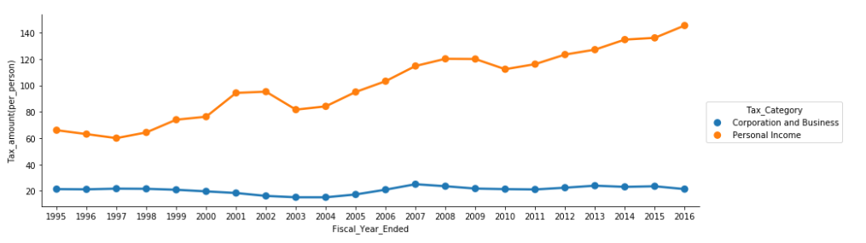
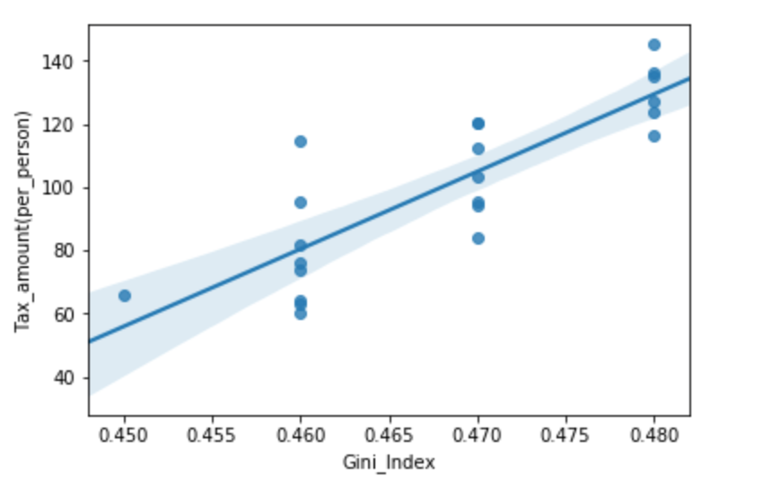
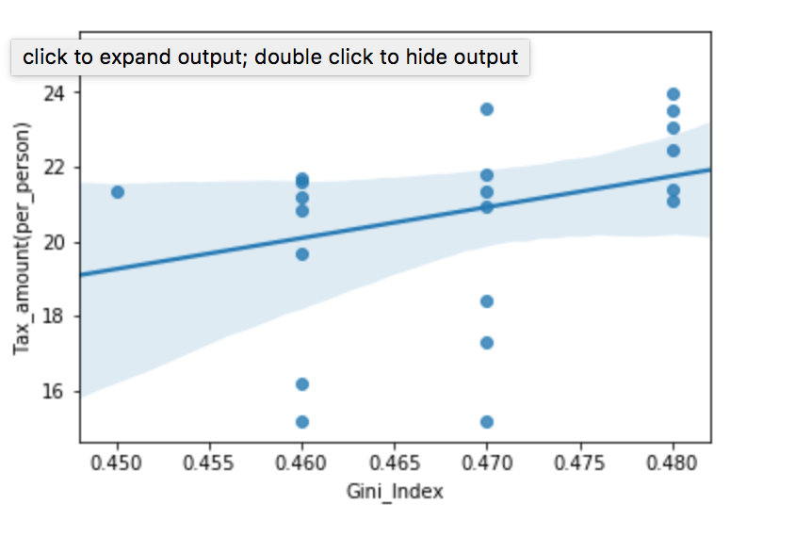
EDA -Correlation between two types of tax with GINI
Personal income tax is increasing while corporation and business tax stays almost the same
Source:DATA.GOV, multipl
Personal income tax has high correlation with GINI
corporation and business tax has not clear correlation with GINI

